Slide 1
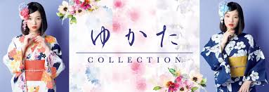
日本の文化
「Yukata Dan Kimono」
Yukata [浴衣」：A yukata is a Japanese garment , a casual summer kimono usually made of cotton or synthetic fabric ,and unlined.

Slide 2
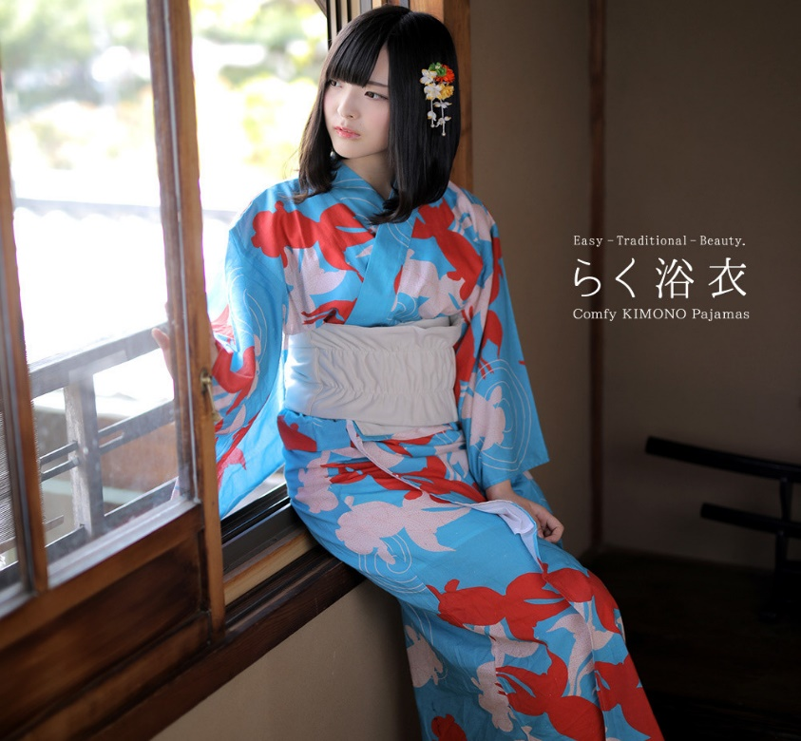
When to wear it ? Yukata are the most popular during the summer months, where the unlined cotton fabric is the most suited to combat the hot temperature . They can be worn around every day; however , it is most
common to see young people enjoying them during the fireworks viewing festivals, known as hanabi in Japanese.

Slide 3
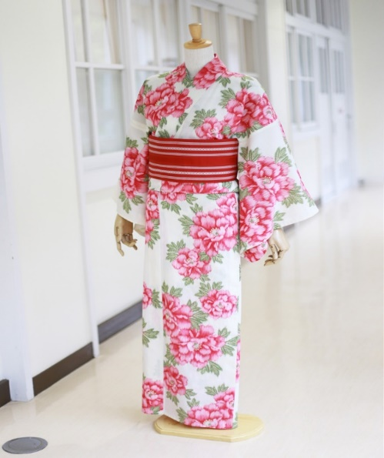
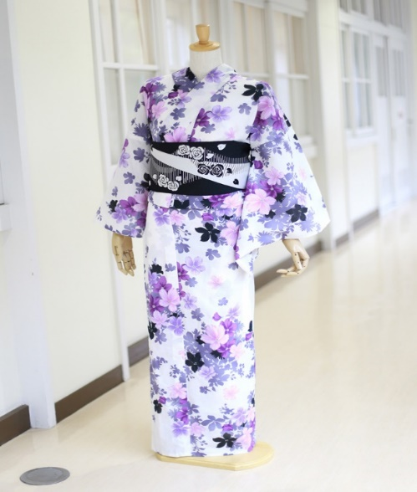
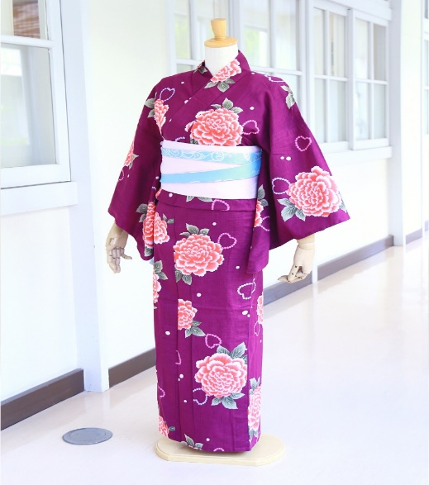
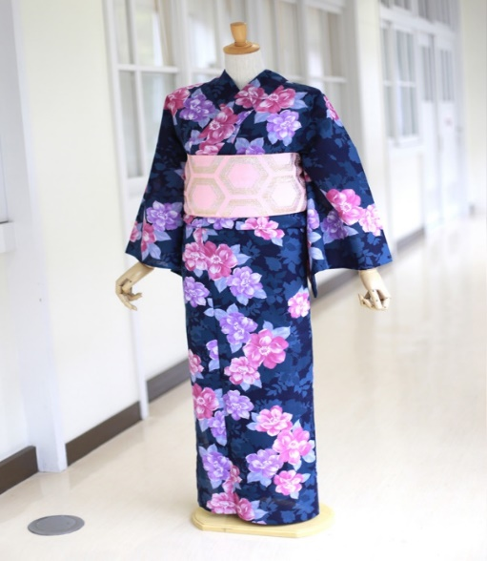
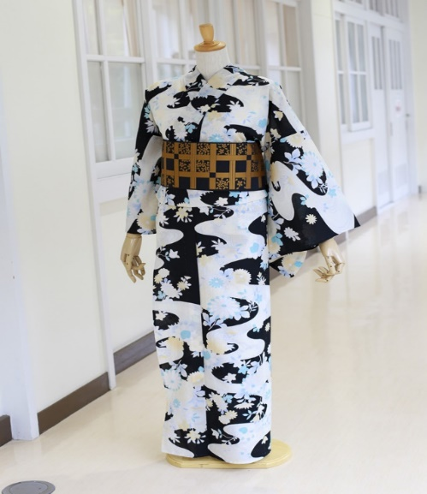
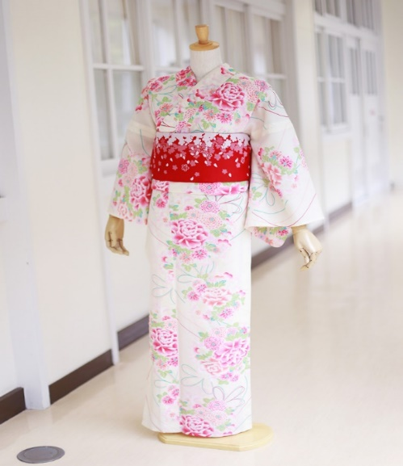
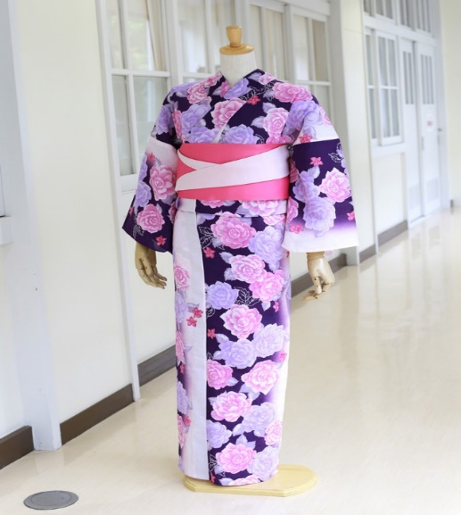
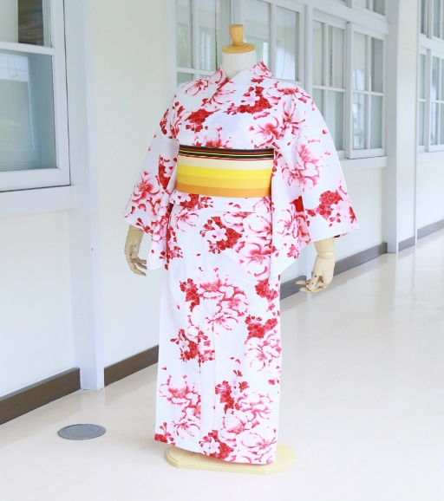
YUKATA DESIGN [LADIES]
New
New
New
New
New
New
New
New

Slide 4
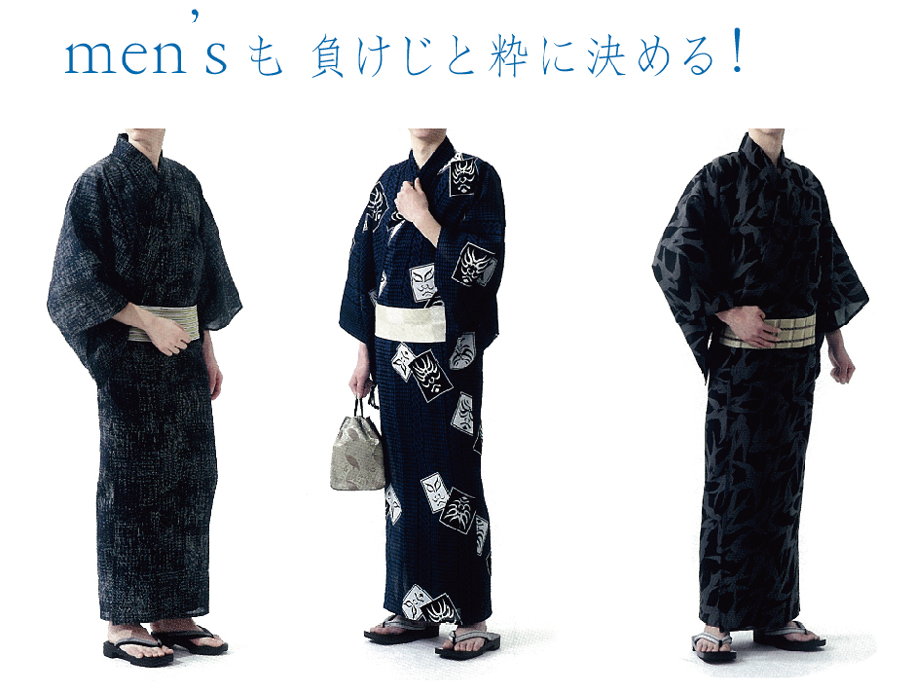
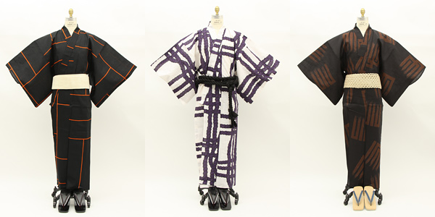
YUKATA DESIGH [ MENS ]

Slide 5
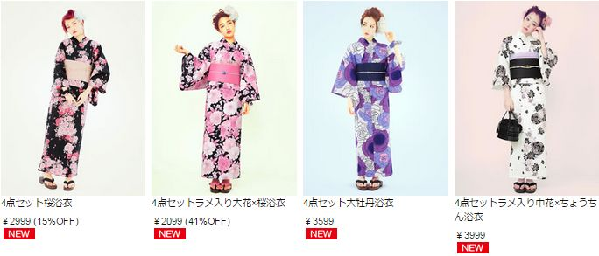
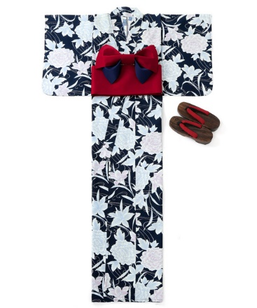
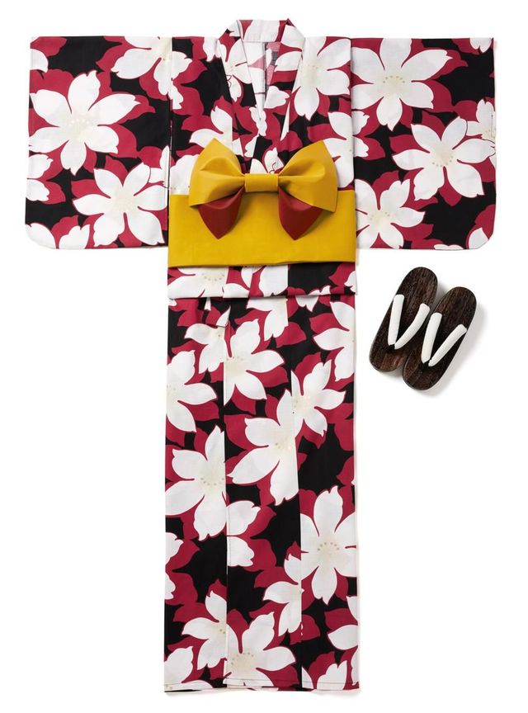
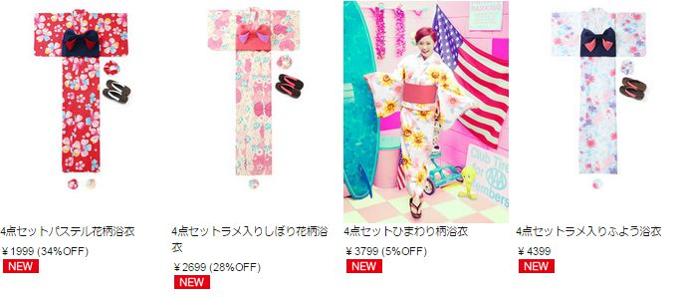
新規浴衣の値段について！

